Slide 1

Perkerson Elementary School GO Team Business Meeting #3
December 4, 2025
4:00 PM

Slide 2

Agenda
Action Items
Approval of Agenda
Approval of Previous Minutes
Additional Action Item 1 (if needed):
Discussion Items (add items as needed)
2025-2030 Strategic Plan Development
Confirm Mission/Vision, Goals from Previous Meeting
Develop 2025-2030 Strategic Plan Objectives
Information Items (add items as needed)
Principal’s Report
2025 CCRPI Results
Cluster Advisory Team Report
Charter System Renewal
FY27 Budget Preparation
Attendance
APS Forward 2040 –Facilities Plan Update (if needed)
Announcements
Public Comment (if needed)
Adjournment

Slide 3

Action Items
Approval of Agenda
Approval of Previous Minutes
Additional Action Item (if needed)

Slide 4
Discussion Items

Slide 5
Continuing the 2025-2030 School Strategic Plan Development Process

Slide 6
School Strategic Planning Overview
Purpose
To cascade the district strategic plan to the school level, while grounding our focus in the school’s Continuous Improvement Plan. This will create alignment, reduce confusion, and simplify our efforts.
Timeline
Our school’s 2030 Strategic Goals and Objectives should be updated, approved and ranked by January 2026. Schools will focus on the strategies as part of FY27 Budget and Continuous Improvement Plan processes.

Slide 7
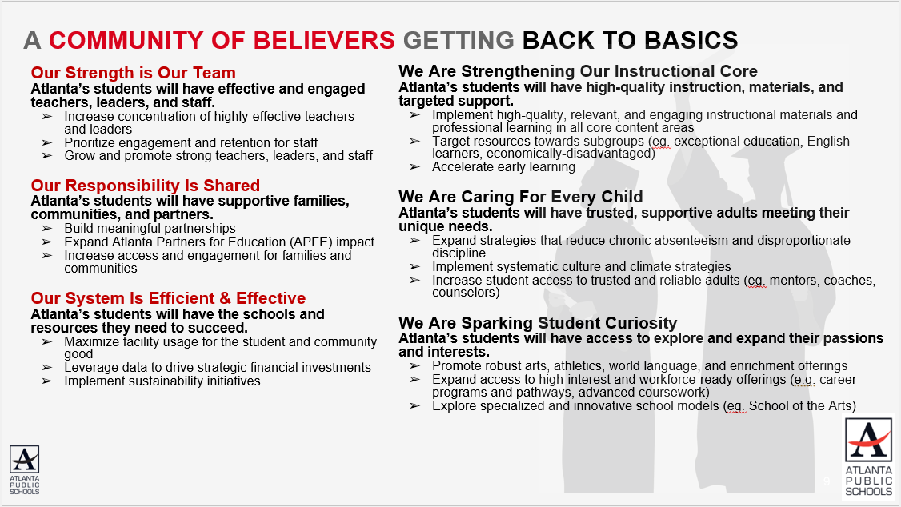
Revisiting the APS 2025-2030 Strategic Plan
Notes:
As a reminder this is the district's 2025-2030 Strategic Plan. We will use this as a guide as we continue our work today to develop our school's 2025-2030 Strategic Plan that is aligned to the district's new plan.

Slide 8
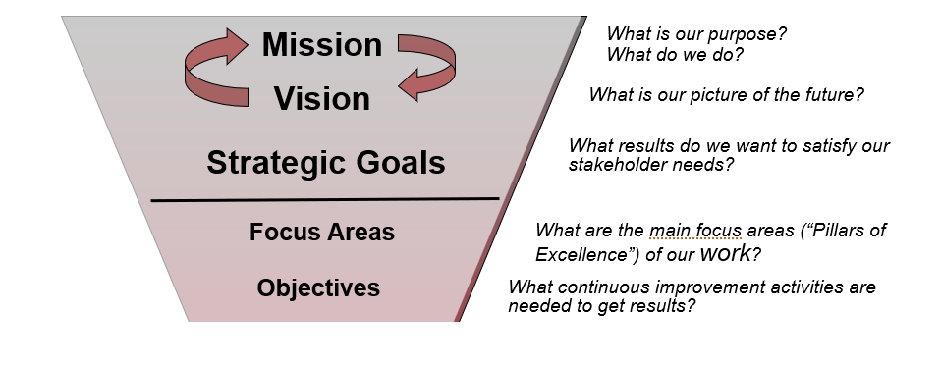
GO Team’s Focus (Governance)
Notes:
These are the governance-aligned portions of the school strategic plan that the GO Team will develop. We will dive into specific strategies and actions, as a part of our budget development process that starts in January.

Slide 9

School Strategic Planning Process Overview
1
Review Data
Sample GO Team Business Meeting Cadence
Business Meeting 1:
Review Data (MAP, GMAS, Graduation Rate, CCRPI, etc.)
Business Meeting 2:
Review Data (School KPIs)
Align Mission/Vision/ Purpose
Confirm 2030 Goals
Business Meeting 3:
Identify 2025-2030 Strategic Objectives
Business Meeting 4 (Budget Allocation):
Approve Your Strategic Plan & Rank Your Strategic Objectives for FY27
2
Align Mission/Vision/Purpose
3
Confirm 2030 Goals
Create CIP Goals to 2030
Identify Additional Goals
4
Identify 2025-2030 Strategic Objectives
Reflect on 2020-2025 Strategic Plan
Review and Discuss Additional Objectives Going Forward
5
Approve Your Strategic Plan & Rank Your Strategic Objectives for FY27

Slide 10
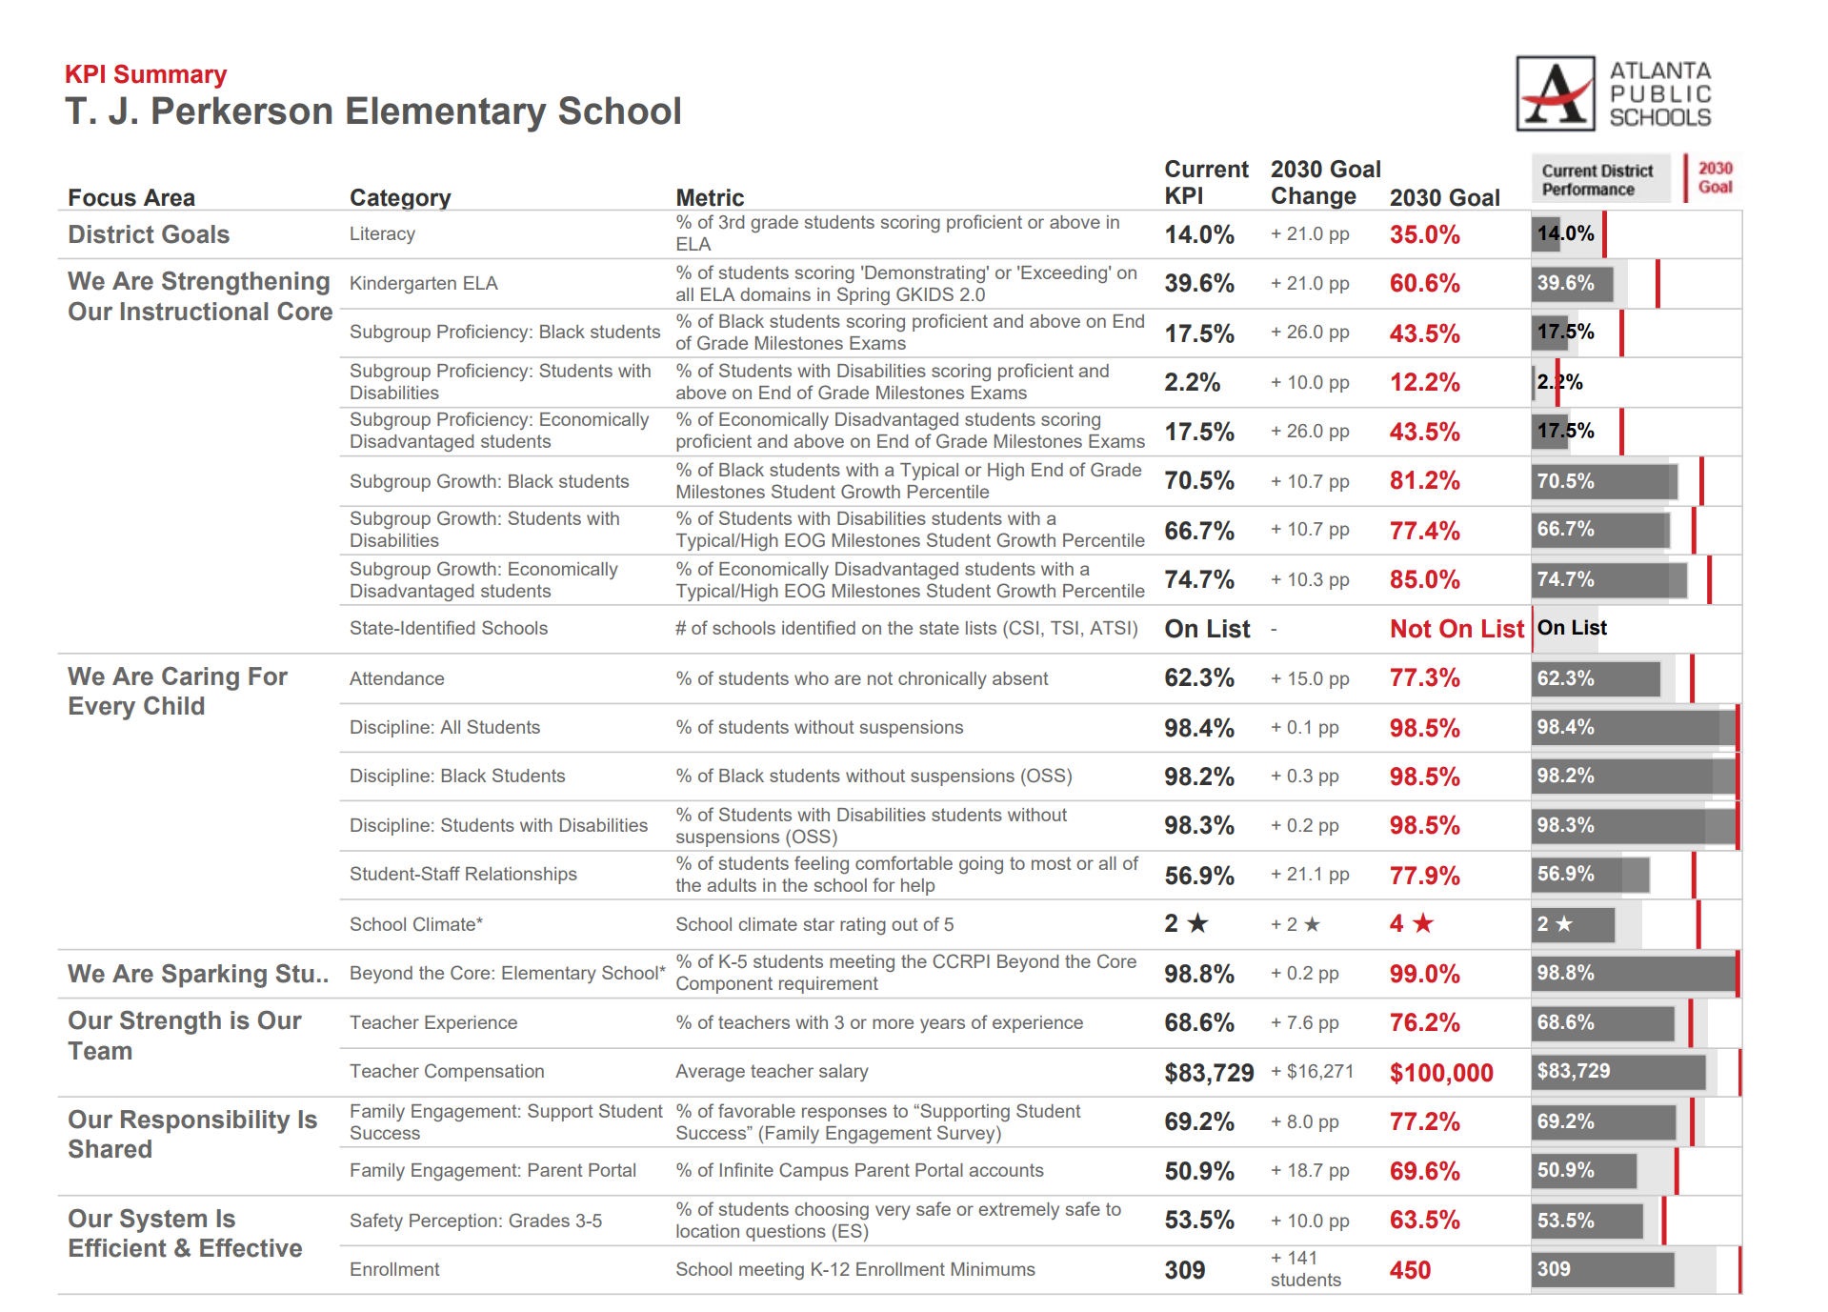
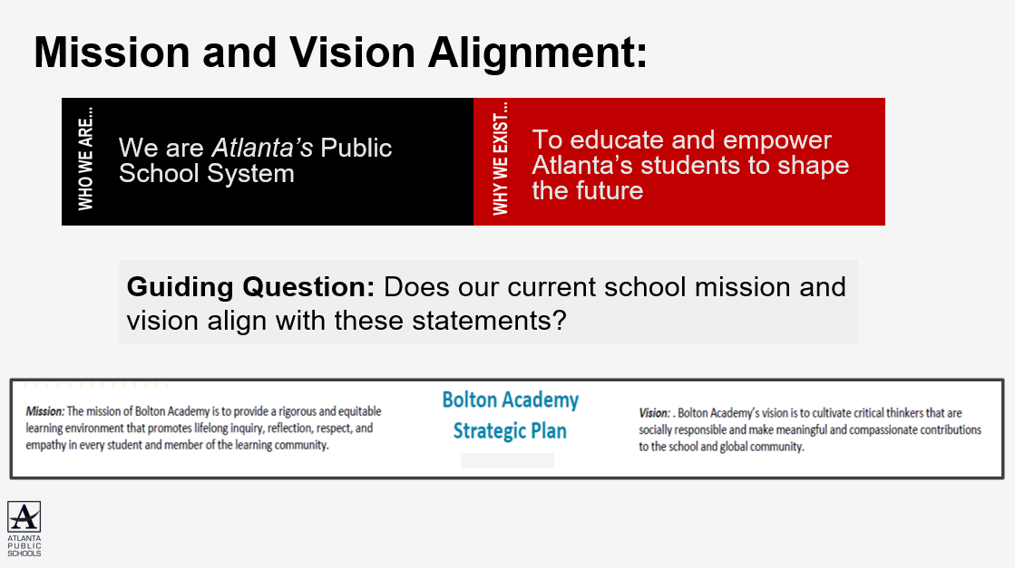
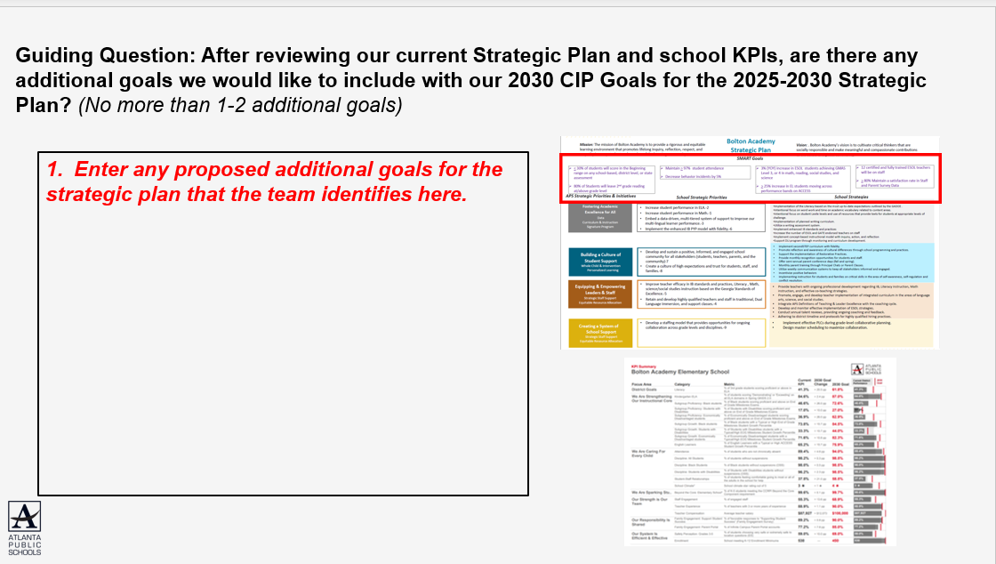
In Our Last Meeting We…
1
Reviewed Our
School Data
2
Aligned Our
Mission and Vision
3
Confirmed Our
2030 Goals

Slide 11
Perkerson Elementary School Proposed Updates to School Mission and Vision:
There were no proposed changes to the school mission and vision based on the GO Team’s discussion during our previous meeting.
Mission:
With a focus on STEAM, students will,
Investigate thoroughly, think Logically, and use creativity to
Develop leadership skills
Vision:
Creating a challenging learning environment where we Achieve excellence,
Think critically and Solve problems

Slide 12

Perkerson Elementary School Proposed Goals for the 2025-2030 Strategic Plan:
By 2030, Perkerson Elementary School will increase the percentage of students performing at Proficiency and Above in Math from 20.5% to 45.5% for All Students, and from 0% to 25% for Students with Disabilities, as measured by the Georgia Milestones Assessment.
By 2030, Perkerson Elementary School will increase the percentage of students performing at Proficient and Above in ELA from 16.8% to at least 41.8% for All Students, and from 5.6% to at least 30.6% for Students with Disabilities, as measured by the Georgia Milestones Assessment.
By 2030, Perkerson Elementary School will increase the % of students who are not chronically absent from 62.3% to 77.3%.
By 2030, Perkerson Elementary School will increase the School Climate Star rating from 2 to 4.

Slide 13

Today’s Focus:
School Strategic Planning Process: Step 4
1
Sample GO Team Business Meeting Cadence
Business Meeting 1:
Review Data (MAP, GMAS, Graduation Rate, CCRPI, etc.)
Business Meeting 2:
Review Data (School KPIs)
Align Mission/Vision/ Purpose
Confirm 2030 Goals
Business Meeting 3:
Identify 2025-2030 Strategic Objectives
Business Meeting 4 (Budget Allocation):
Approve Your Strategic Plan & Rank Your Strategic Objectives for FY27
Review Data
2
Align Mission/Vision/Purpose
3
Confirm 2030 Goals
Create CIP Goals to 2030
Identify Additional Goals
4
Identify 2025-2030 Strategic Objectives
Reflect on 2020-2025 Strategic Plan
Review and Discuss Additional Objectives Going Forward
5
Approve Your Strategic Plan & Rank Your Strategic Objectives for FY27

Slide 14
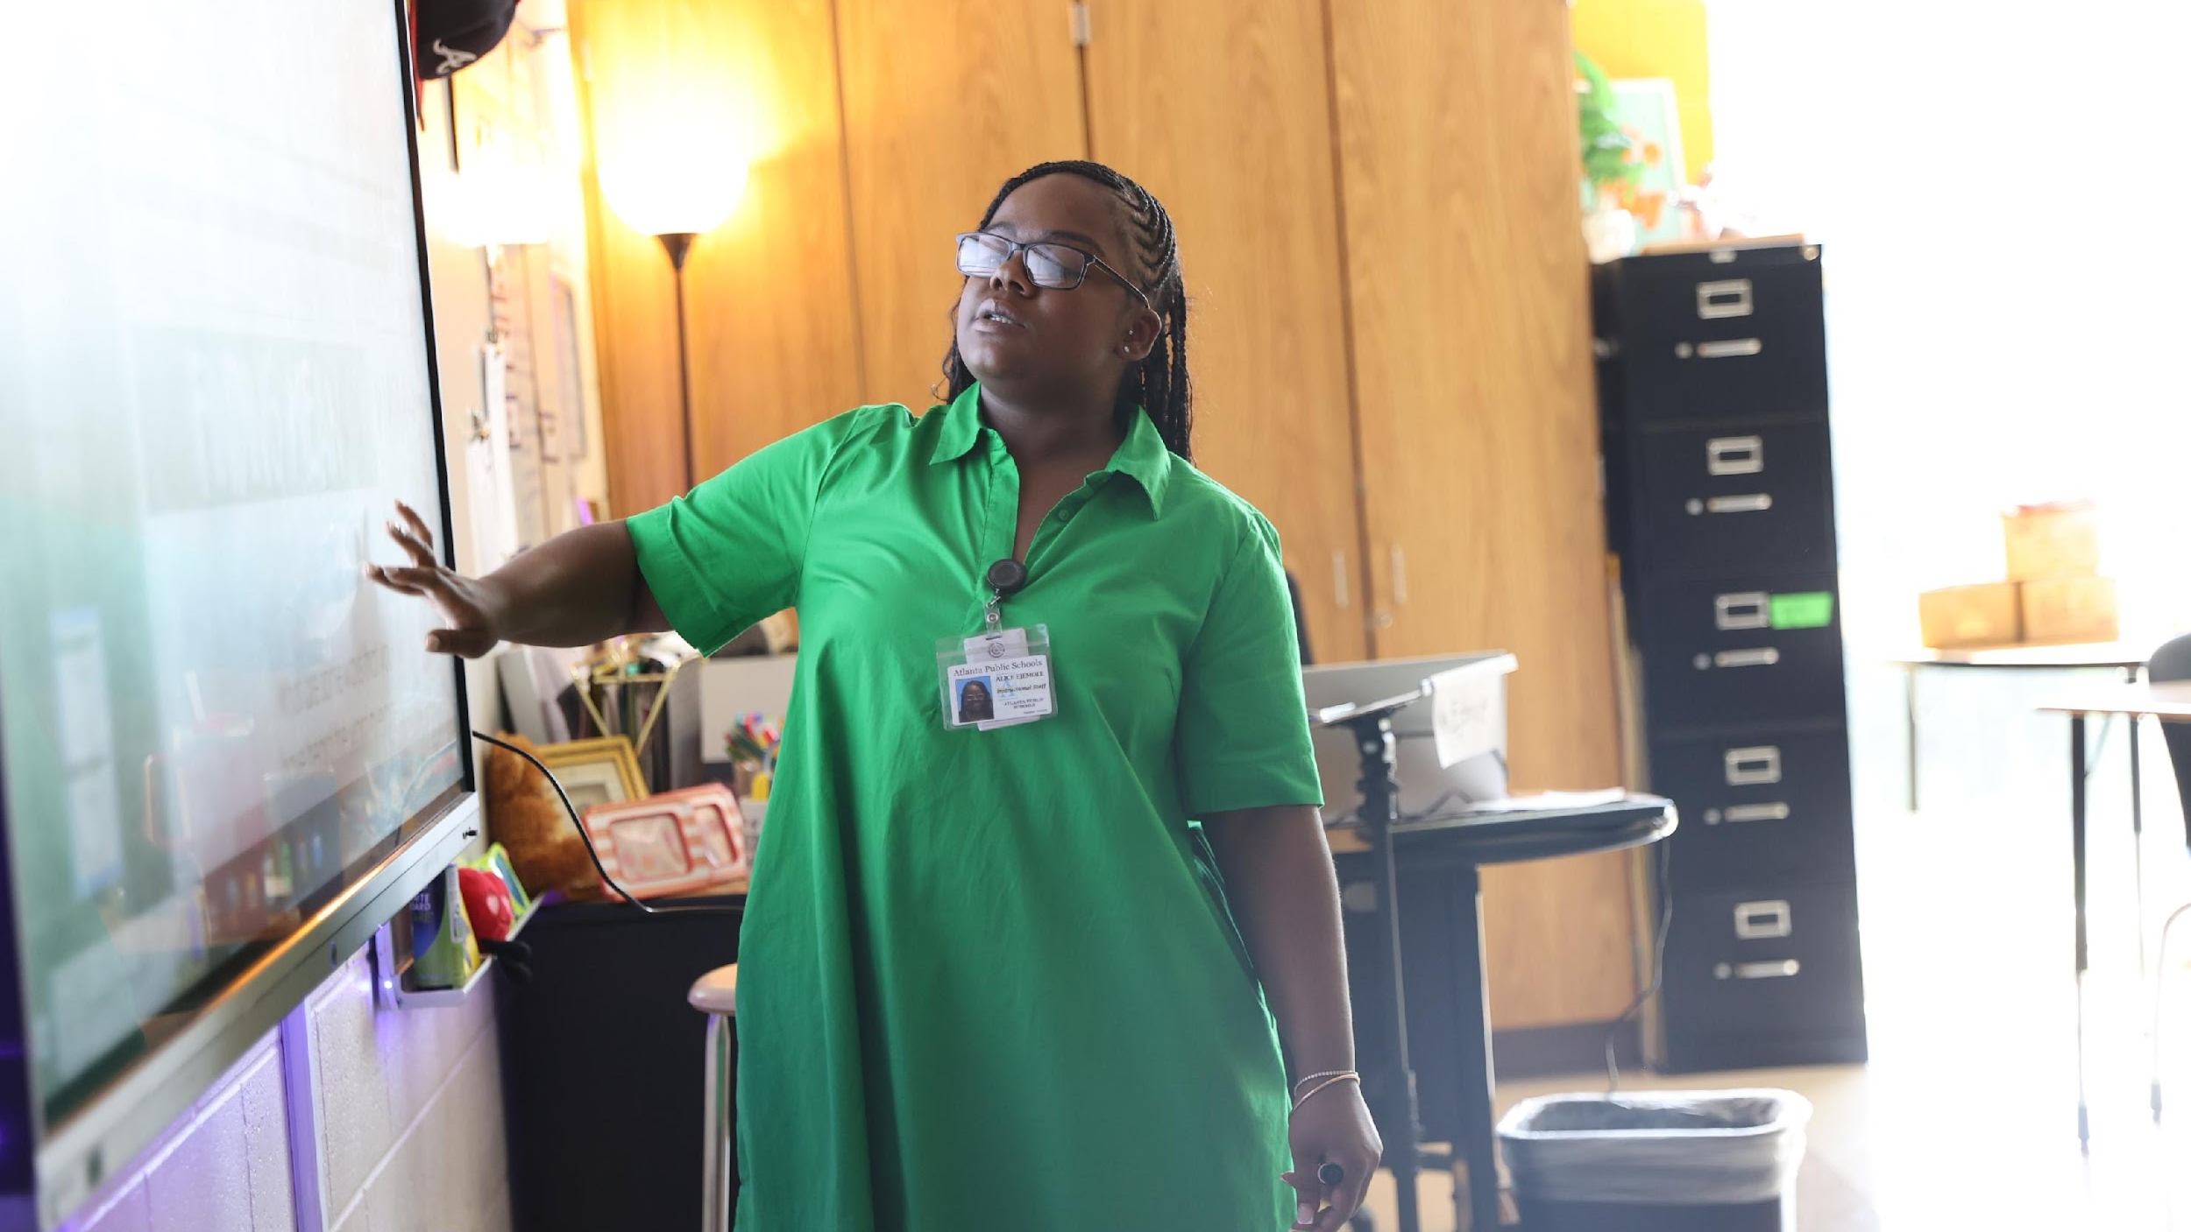

4. Identify 2025-2030 Strategic Objectives
Reflect on 2020-2025 Strategic Plan (Stop, Continue)
Align Objectives to the District's new Focus Areas
Review and Discuss Additional Objectives Going Forward (Start)
One District. One Goal. Every Child.

Slide 15
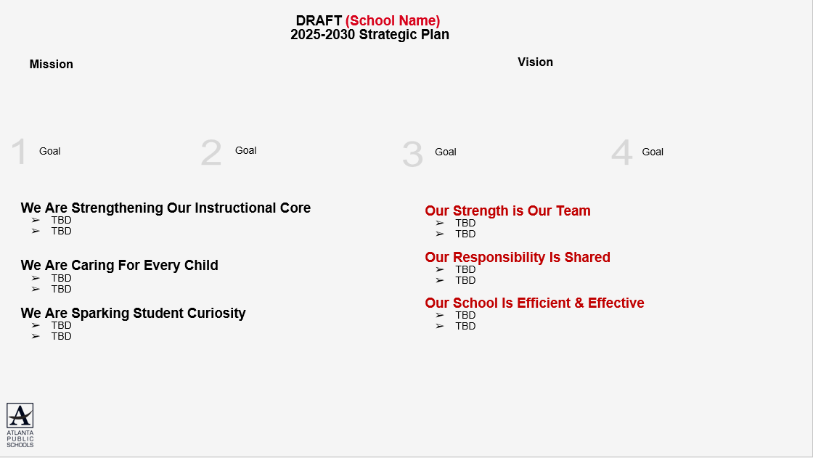
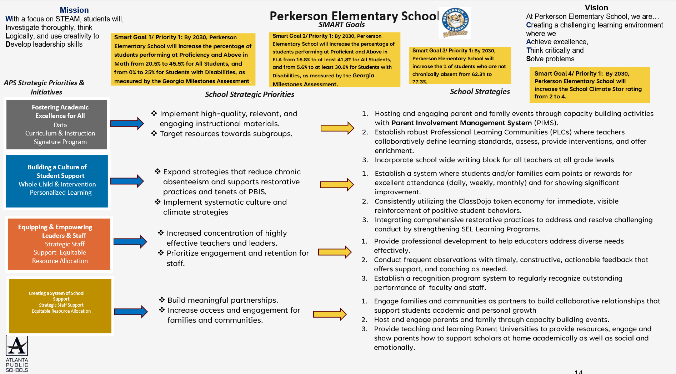
4
Using our new, 2025-2030 Strategic Goals as a guide we will complete a Start, Stop and Continue exercise to review our current “Strategic Priorities” and identify our 2025-2030 Strategic Objectives

Slide 16

Mission
With a focus on STEAM, students will,
Investigate thoroughly, think
Logically, and use creativity to
Develop leadership skills
Perkerson Elementary School
Vision
At Perkerson Elementary School, we are…
Creating a challenging learning environment where we
Achieve excellence,
Think critically and
Solve problems
SMART Goals
Smart Goal 1/ Priority 1: By 2030, Perkerson Elementary School will increase the percentage of students performing at Proficiency and Above in Math from 20.5% to 45.5% for All Students, and from 0% to 25% for Students with Disabilities, as measured by the Georgia Milestones Assessment.
Smart Goal 2/ Priority 1: By 2030, Perkerson Elementary School will increase the percentage of students performing at Proficient and Above in ELA from 16.8% to at least 41.8% for All Students, and from 5.6% to at least 30.6% for Students with Disabilities, as measured by the Georgia Milestones Assessment.
Smart Goal 3/ Priority 1: By 2030, Perkerson Elementary School will increase the % of students who are not chronically absent from 62.3% to 77.3%.
Smart Goal 4/ Priority 1: By 2030, Perkerson Elementary School will increase the School Climate Star rating from 2 to 4.
APS Strategic Priorities & Initiatives
School Strategic Priorities
School Strategies
Fostering Academic Excellence for All
Data
Curriculum & Instruction Signature Program
Implement high-quality, relevant, and engaging instructional materials.
Target resources towards subgroups.
Hosting and engaging parent and family events through capacity building activities with Parent Involvement Management System (PIMS).
Establish robust Professional Learning Communities (PLCs) where teachers collaboratively define learning standards, assess, provide interventions, and offer enrichment.
Incorporate school wide writing block for all teachers at all grade levels
Building a Culture of Student Support
Whole Child & Intervention Personalized Learning
Expand strategies that reduce chronic absenteeism and supports restorative practices and tenets of PBIS.
Implement systematic culture and climate strategies
Establish a system where students and/or families earn points or rewards for excellent attendance (daily, weekly, monthly) and for showing significant improvement.
Consistently utilizing the ClassDojo token economy for immediate, visible reinforcement of positive student behaviors.
Integrating comprehensive restorative practices to address and resolve challenging conduct by strengthening SEL Learning Programs.
Equipping & Empowering Leaders & Staff
Strategic Staff Support Equitable Resource Allocation
Increased concentration of highly effective teachers and leaders.
Prioritize engagement and retention for staff.
Provide professional development to help educators address diverse needs effectively.
Conduct frequent observations with timely, constructive, actionable feedback that offers support, and coaching as needed.
Establish a recognition program system to regularly recognize outstanding performance of faculty and staff.
Creating a System of School Support
Strategic Staff Support
Equitable Resource Allocation
Build meaningful partnerships.
Increase access and engagement for families and communities.
Engage families and communities as partners to build collaborative relationships that support students academic and personal growth
Host and engage parents and family through capacity building events.
Provide teaching and learning Parent Universities to provide resources, engage and show parents how to support scholars at home academically as well as social and emotionally.
14

Slide 17
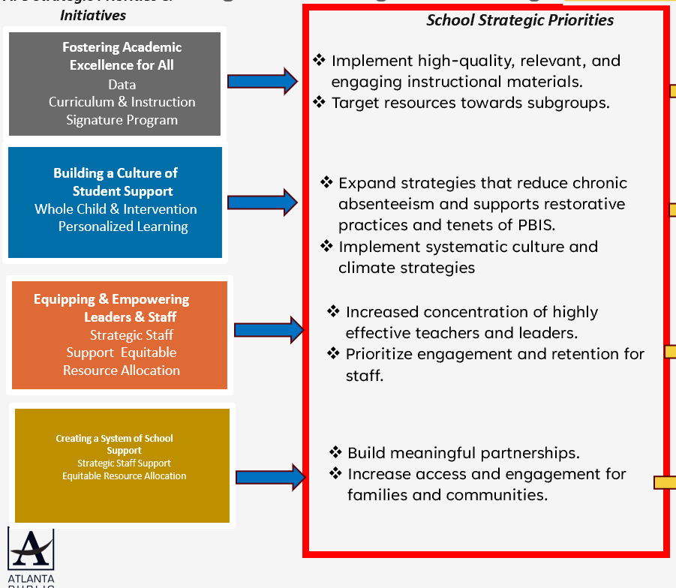
Identifying 2025-2030 Strategic Objectives: Stop Discussion
Strategic Plan
Guiding Questions:
Stop
- What current priorities/activities are not having the needed impact and should be stopped?
- Are there any priorities/activities that are no longer aligned with our mission, vision, goals or focus areas?
Notes:
Think about what has been working; has been completed; or never started.
If your goals for 2030 are bigger than what you have achieved so far, then what must you do differently going forward?

Slide 18

Identifying 2025-2030 Strategic Objectives: Continue Discussion
Strategic Plan
Guiding Questions:
Continue
- What current priorities/activities are working well and should be maintained?
Notes:
Think about what has been working; has been completed; or never started.
If your goals for 2030 are bigger than what you have achieved so far, then what must you do differently going forward?

Slide 19
Identifying 2025-2030 Strategic Objectives: Continue Discussion
Enter the “Strategic Priorities” from your 2020-2025 Strategic Plan that you and your GO Team think should continue as “Strategic Objectives” on your 2025-2030 Strategic Plan based on today’s discussion.
Implement high-quality, relevant, and engaging instructional materials.
Target resources towards subgroups..
Expand strategies that reduce chronic absenteeism and supports restorative practices and tenets of PBIS.
Implement systematic culture and climate strategies
Increased concentration of highly effective teachers and leaders.
Prioritize engagement and retention for staff.
Build meaningful partnerships.
Increase access and engagement for families and communities.

Slide 20
Aligning Your Objectives to the District's New Focus Areas
“Getting Back to Basics”
“Community of Believers”
We Are Strengthening Our Instructional Core
Implement high-quality, relevant, and engaging instructional materials.
Target resources towards subgroups.
We Are Caring For Every Child
We Are Sparking Student Curiosity
Our Strength is Our Team
Our Responsibility Is Shared
Our School Is Efficient & Effective
Hosting and engaging parent and family events through capacity building activities with Parent Involvement Management System (PIMS).
Establish robust Professional Learning Communities (PLCs) where teachers collaboratively define learning standards, assess, provide interventions, and offer enrichment.
Incorporate school wide writing block for all teachers at all grade levels
Increased concentration of highly effective teachers and leaders.
Prioritize engagement and retention for staff.
Provide professional development to help educators address diverse needs effectively.
Conduct frequent observations with timely, constructive, actionable feedback that offers support, and coaching as needed.
Establish a recognition program system to regularly recognize outstanding performance of faculty and staff.
Expand strategies that reduce chronic absenteeism and supports restorative practices and tenets of PBIS.
Implement systematic culture and climate strategies
Build meaningful partnerships.
Increase access and engagement for families and communities.
Establish a system where students and/or families earn points or rewards for excellent attendance (daily, weekly, monthly) and for showing significant improvement.
Consistently utilizing the ClassDojo token economy for immediate, visible reinforcement of positive student behaviors.
Integrating comprehensive restorative practices to address and resolve challenging conduct by strengthening SEL Learning Programs.
Engage families and communities as partners to build collaborative relationships that support students academic and personal growth
Host and engage parents and family through capacity building events.
Provide teaching and learning Parent Universities to provide resources, engage and show parents how to support scholars at home academically as well as social and emotionally.
Notes:
Use the APS 2025-2030 Strategic Plan (slide 7) and your school's KPI sheet to help guide your team's discussion of how your objectives align to the district's new focus areas.

Slide 21
Identifying 2025-2030 Strategic Objectives: “Start” Discussion
After you have aligned your Objectives to the appropriate Focus Area, identify any new Objectives the school must start to address the goals in your plan
You should have 1-2 Objectives for each Focus Area.
Use the APS 2025-2030 Strategic Plan (slide 7) and your school KPI sheet for ideas if you need to identify new Objectives.
Focus on the “Getting Back to Basics” Focus Areas first (Strengthening Our Instructional Core, Caring For Every Child, and Sparking Student Curiosity)
Make sure you have something in the “Community of Believers” Focus Areas that support your core work (Strength is Our Team, Responsibility is Shared, System is Effective & Efficient)

Slide 22
Guiding Questions: Are there any new “objectives” we must START to completely address our 2025-2030 Strategic Goals? Do we have 1-2 Objectives to support each Focus Area?
“Getting Back to Basics”
“Community of Believers”
We Are Strengthening Our Instructional Core
TBD- Strategic Objective
TBD- Strategic Objective
Implement high-quality, relevant, and engaging instructional materials.
Target resources towards subgroups.
We Are Caring For Every Child
TBD- Strategic Objective
TBD- Strategic Objective
Expand strategies that reduce chronic absenteeism and supportsrestorative practices and tenets of PBIS.
Implement systematic culture and climate strategies
We Are Sparking Student Curiosity
TBD- Strategic Objective
TBD- Strategic Objective
Beyond the Core
Utilization of STEAM
Our Strength is Our Team
TBD- Strategic Objective
TBD- Strategic Objective
Hosting and engaging parent and family events through capacity building activities with Parent Involvement Management System (PIMS).
Establish robust Professional Learning Communities (PLCs) where teachers collaboratively define learning standards, assess, provide interventions, and offer enrichment.
Incorporate school wide writing block for all teachers at all grade levels
Our Responsibility Is Shared
TBD- Strategic Objective
TBD- Strategic Objective
Establish a system where students and/or families earn points or rewards for excellent attendance (daily, weekly, monthly) and for showing significant improvement.
Consistently utilizing the ClassDojo token economy for immediate, visible reinforcement ofpositive student behaviors.
Integrating comprehensive restorative practices to address and resolve challenging conduct bystrengthening SEL Learning Programs.
Our School Is Efficient & Effective
TBD- Strategic Objective
TBD- Strategic Objective
Build meaningful partnerships.
Increase access and engagement for families and communities

Slide 23
Where we’re going
At our next meeting we will:
Vote on the 2025-2030 Strategic Plan
Rank our 2025-2030 Strategic Objectives
Begin the discussion of the 2026-2027 budget
Let me or the Chair know of any additional information you need for our future discussion.

Slide 24

Questions?

Slide 25
Information Items

Slide 26
Principal’s Report

Slide 27
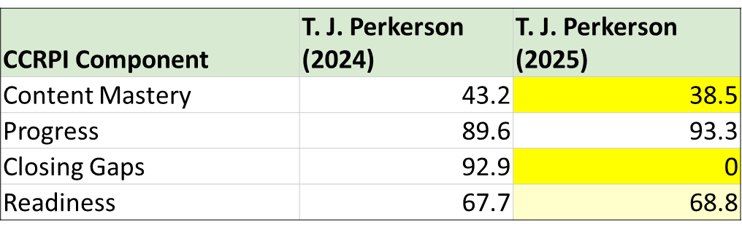
CCRPI Summary Data Summary Data

Slide 28

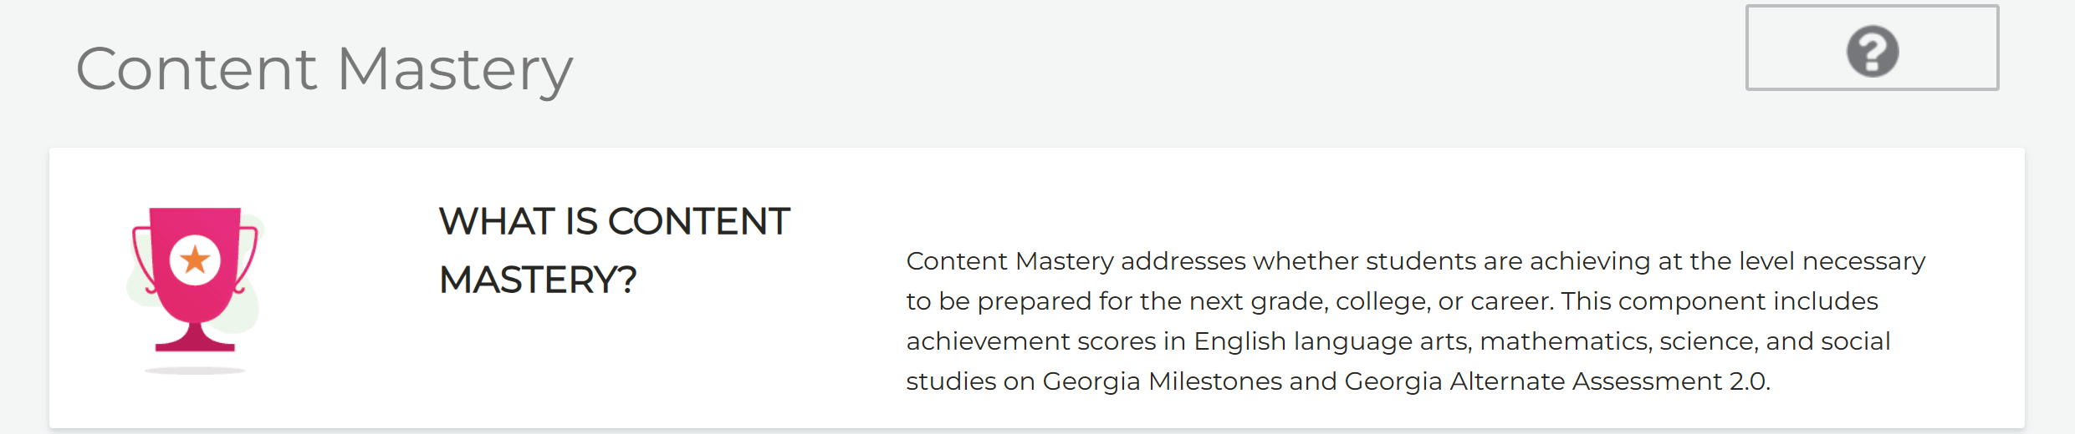
CCRPI What does it mean?

Slide 29
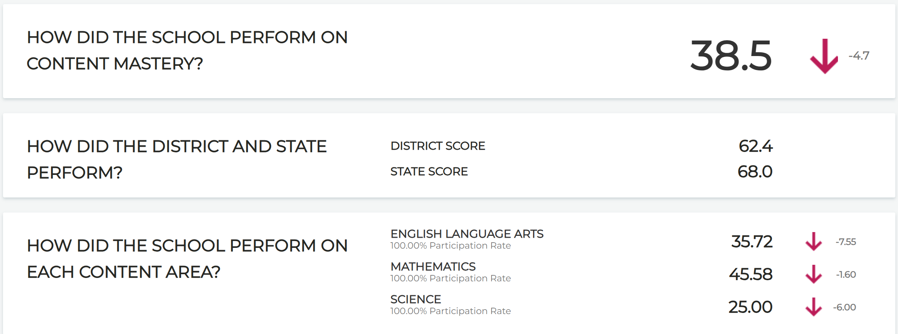
Content mastery

Slide 30

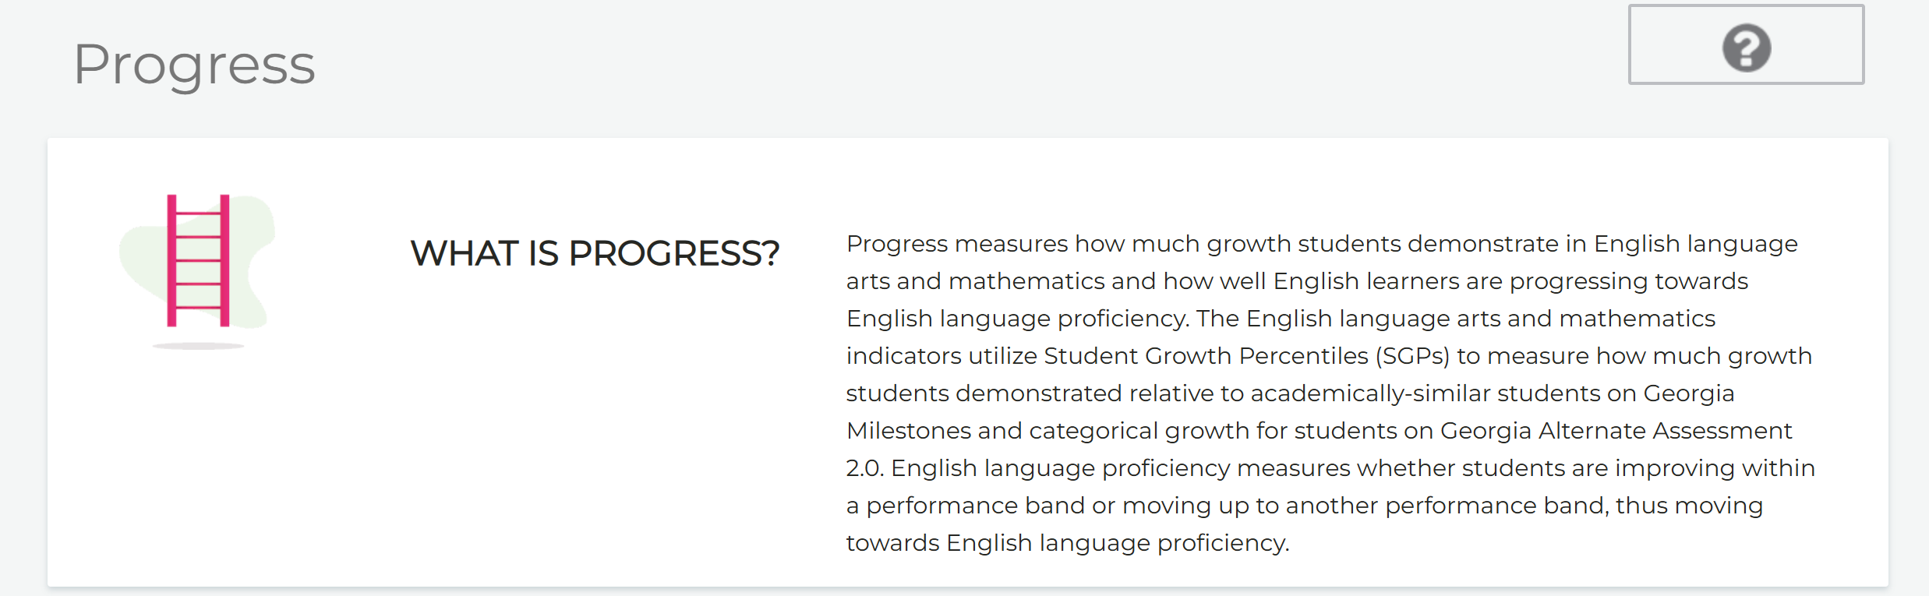
CCRPI What does it mean?

Slide 31
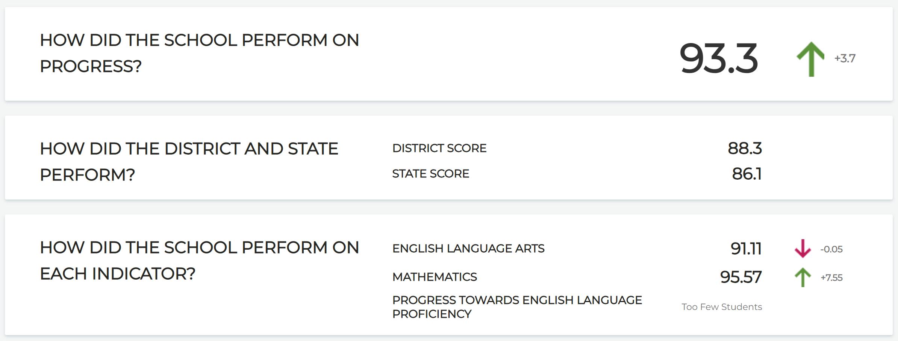
Progress

Slide 32

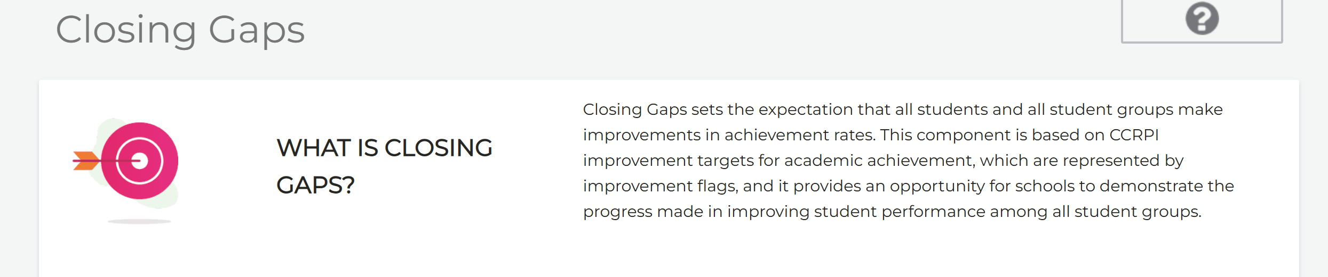
CCRPI What does it mean?

Slide 33
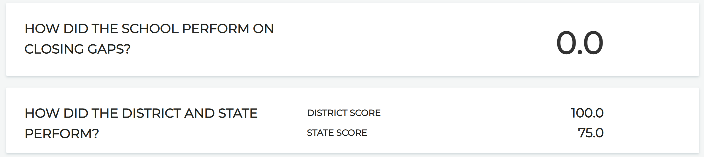
Closing The Gap

Slide 34
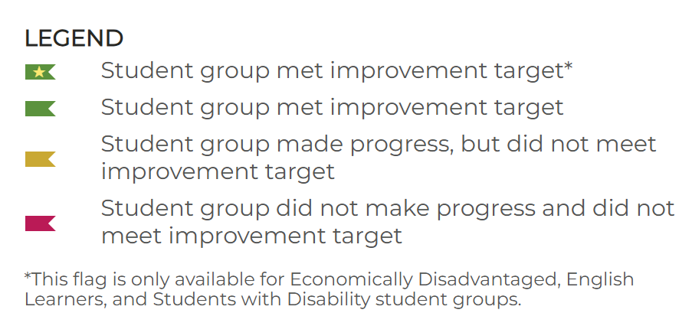
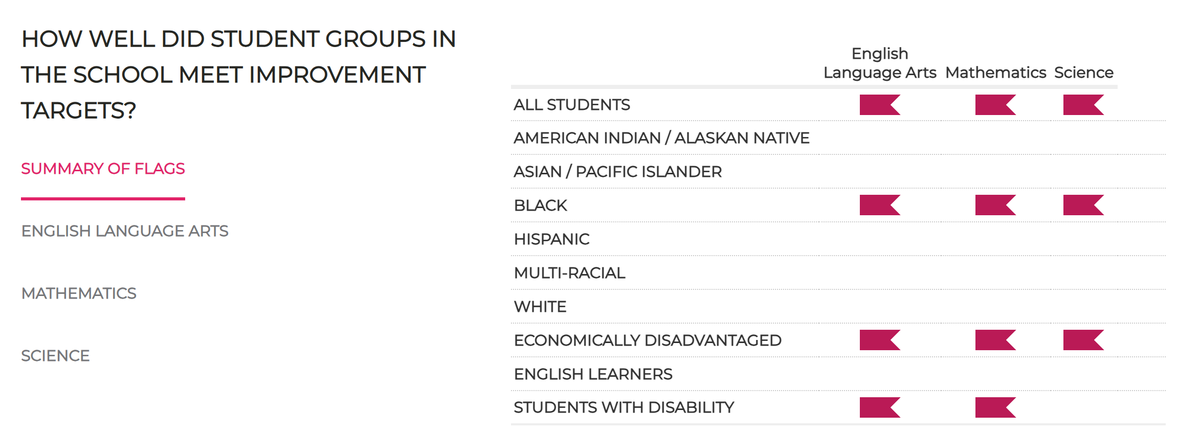
Closing the Gap flags Summary

Slide 35

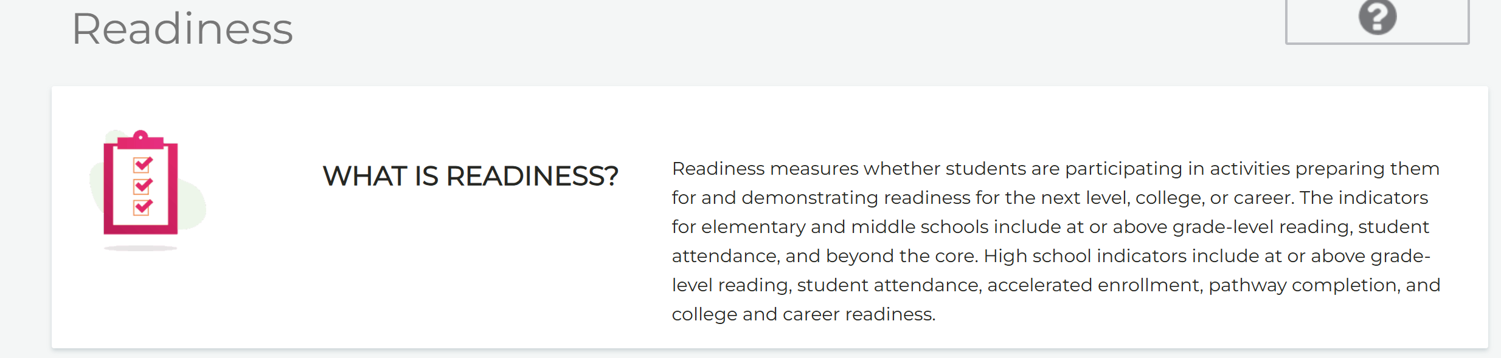
CCRPI What does it mean?

Slide 36
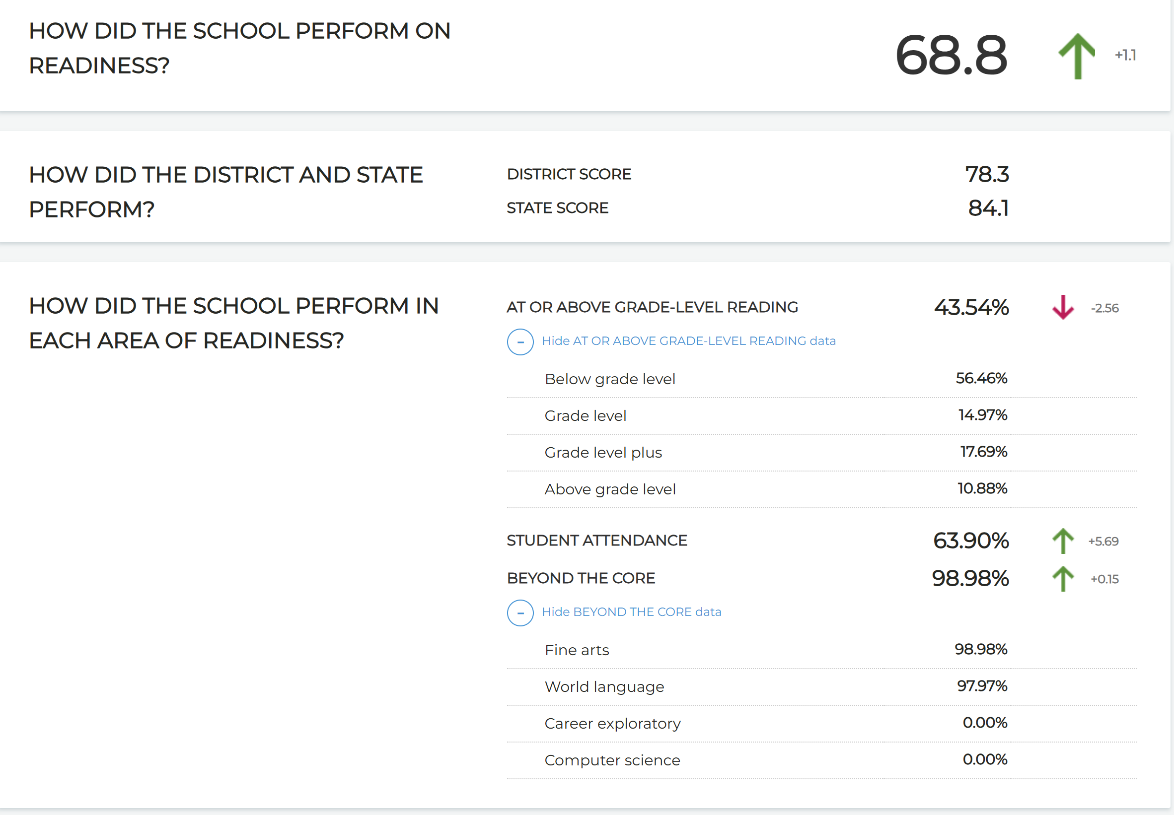
Readiness

Slide 37
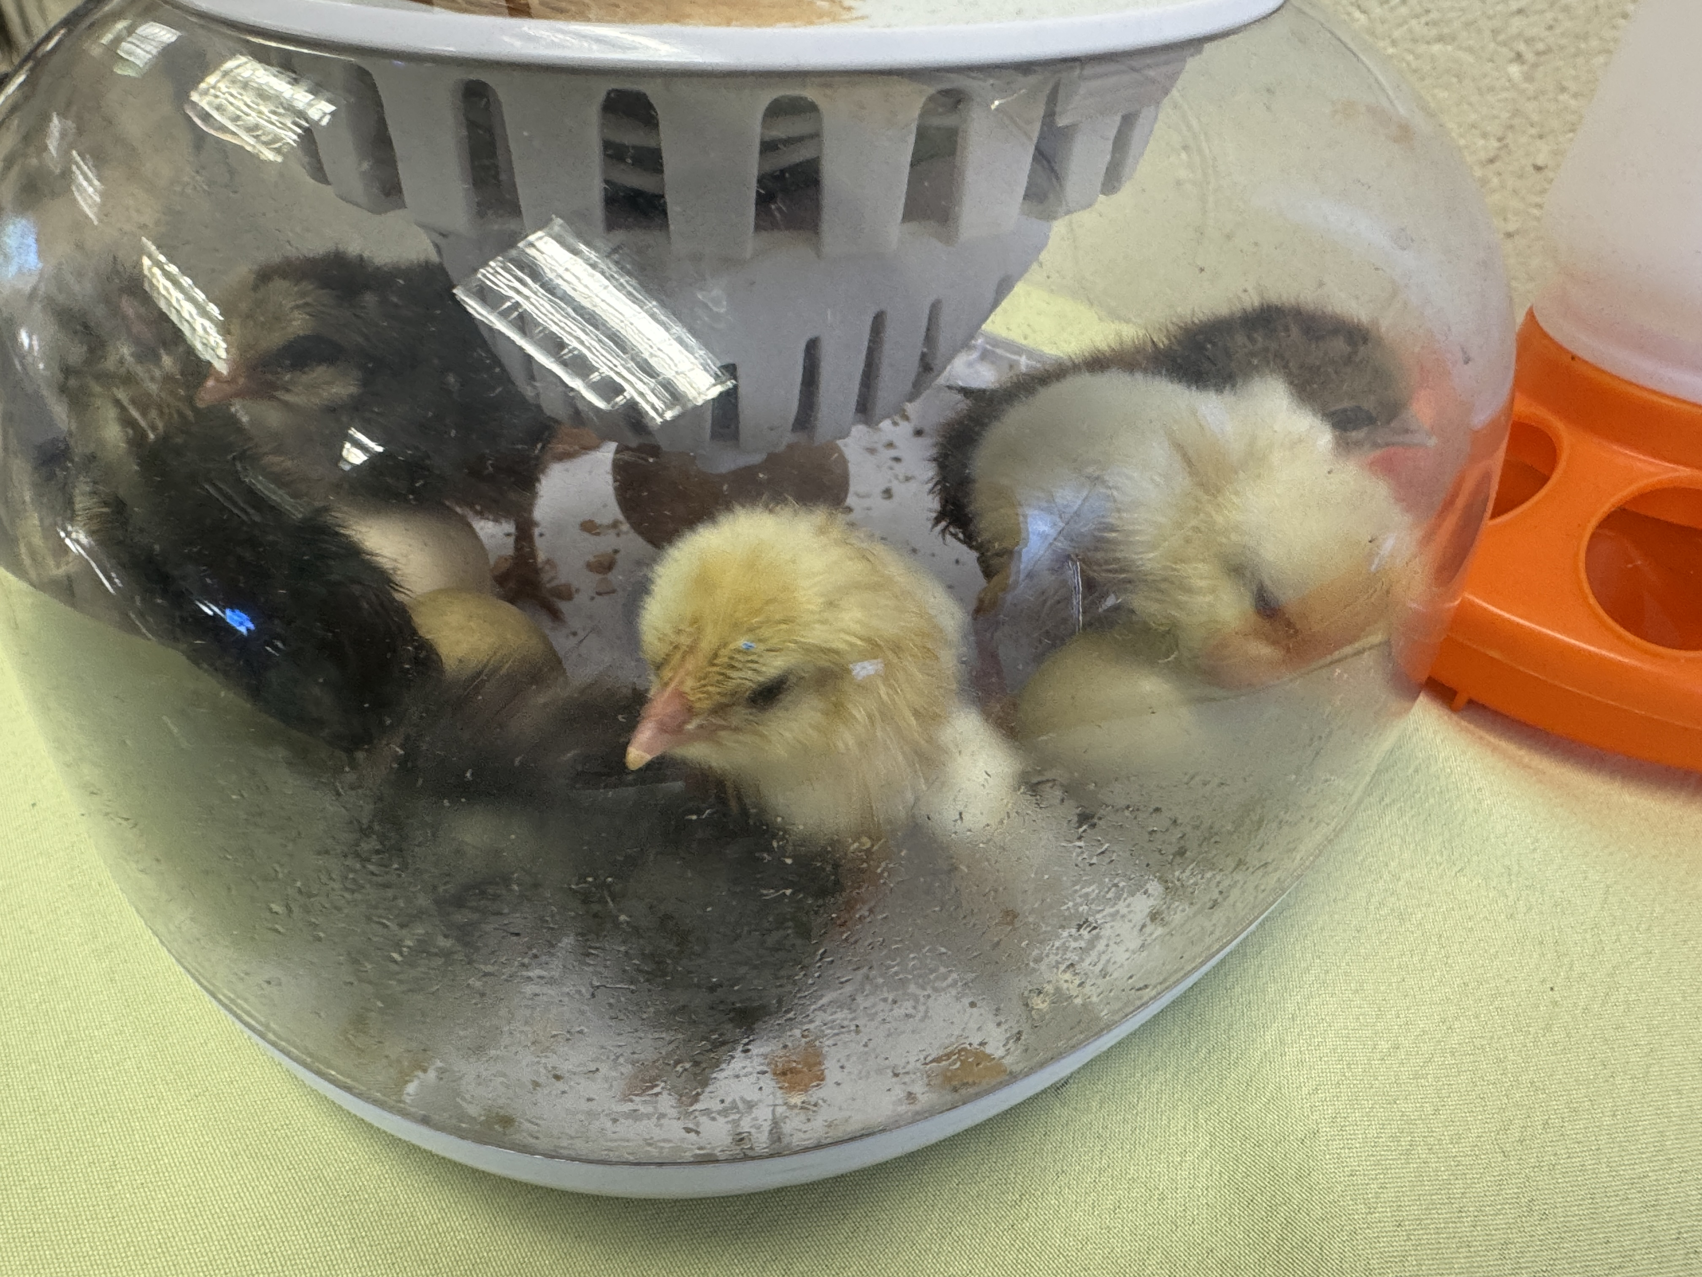
SCHOOL UPDATES
The Chickens are here and require a vacation home in December!
Mr. Taylor received a $500.00 STEM Grant
Parent Climate Survey Coming up
Mother/Son Winter Wonderland
MAP Testing/Celebration Coming
5th Grade Parent Meeting Coming
Attendance Challenge for December
Holiday Program

Slide 38

Cluster Advisory Team Report
Charter System Renewal
FY27 Budget Preparation
Attendance

Slide 39


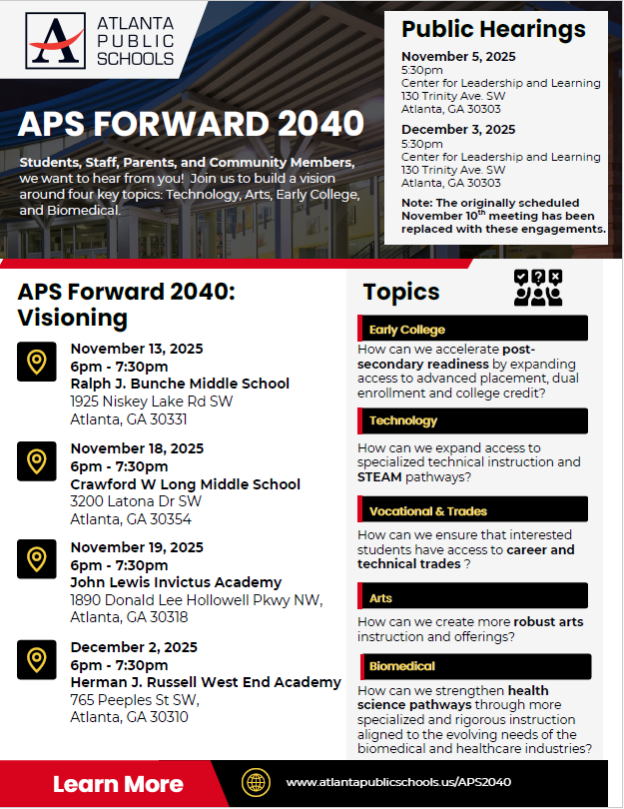

UPDATE
Comprehensive Long-Range Facilities Plan
www.atlantapublicschools.us/APS2040
Notes:
Next on our agenda, we’d like to welcome our representative to the Long-Range Comprehensive Facilities Master Plan Taskforce. As many of you know, this taskforce plays a key role in shaping the future of our district’s facilities — ensuring they are aligned with projected enrollment, instructional needs, safety standards, and long-term community use."
Over the summer, the taskforce has been hard at work reviewing data, exploring options, and engaging in important planning conversations. [Name of Representative] will share an update on what’s been done so far, any key decisions or recommendations that have been made, and what’s ahead — including opportunities for the public to provide input.
[Allow the FMP representative to provide an update and answers questions. After this is concluded:]
Thank you [Name of Representative].
A report will be presented to the Board at its August 11 meeting, and the options will become public the week of August 18.
There are several upcoming public meetings where you can learn more and share your thoughts. The next public meetings are scheduled for: August 25, October 20, and November 10
On each date, there will be a virtual meeting at noon and an in-person meeting at the Central Office at 6PM.
I strongly encourage you all to attend these meetings. This is a critical time for public input, and your voice is essential.

Slide 40
Thank you

Slide 41
DRAFT (School Name)
2025-2030 Strategic Plan Template
Mission
Vision
1
Strategic Goal
2
Strategic Goal
3
Strategic Goal
4
Strategic Goal
We Are Strengthening Our Instructional Core
TBD- Strategic Objective
TBD- Strategic Objective
We Are Caring For Every Child
TBD- Strategic Objective
TBD- Strategic Objective
We Are Sparking Student Curiosity
TBD- Strategic Objective
TBD- Strategic Objective
Our Strength is Our Team
TBD- Strategic Objective
TBD- Strategic Objective
Our Responsibility Is Shared
TBD- Strategic Objective
TBD- Strategic Objective
Our School Is Efficient & Effective
TBD- Strategic Objective
TBD- Strategic Objective

